Slide 1
Multi-agent structures
and agentic mesh with A2A

Slide 2

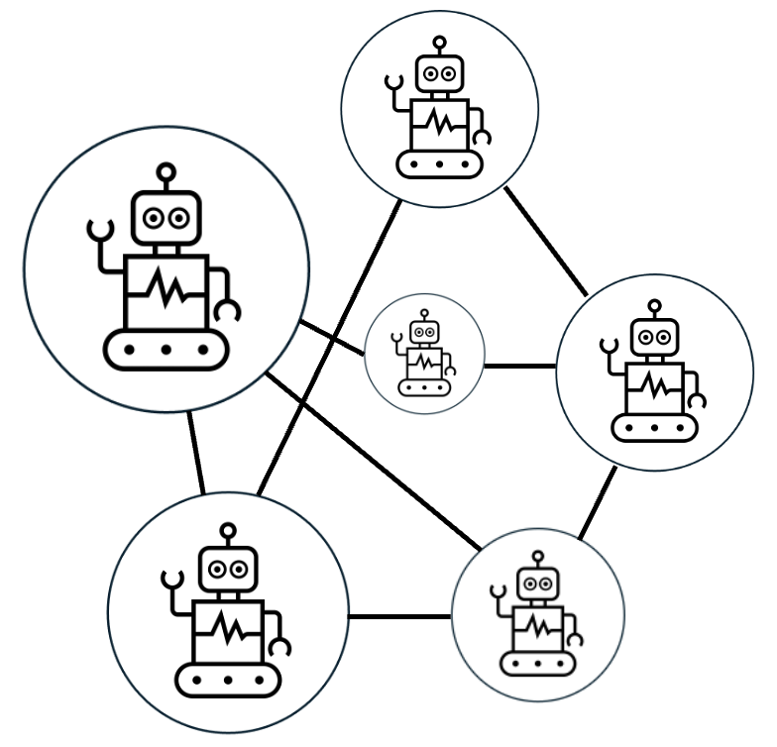

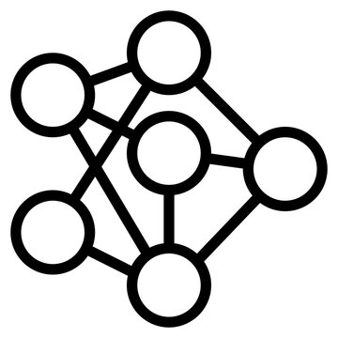

Tools
+
LLM
Agent
Agentic AI

Slide 3
Agents in multi-agent structures can be organized into different hierarchical structures

Slide 4

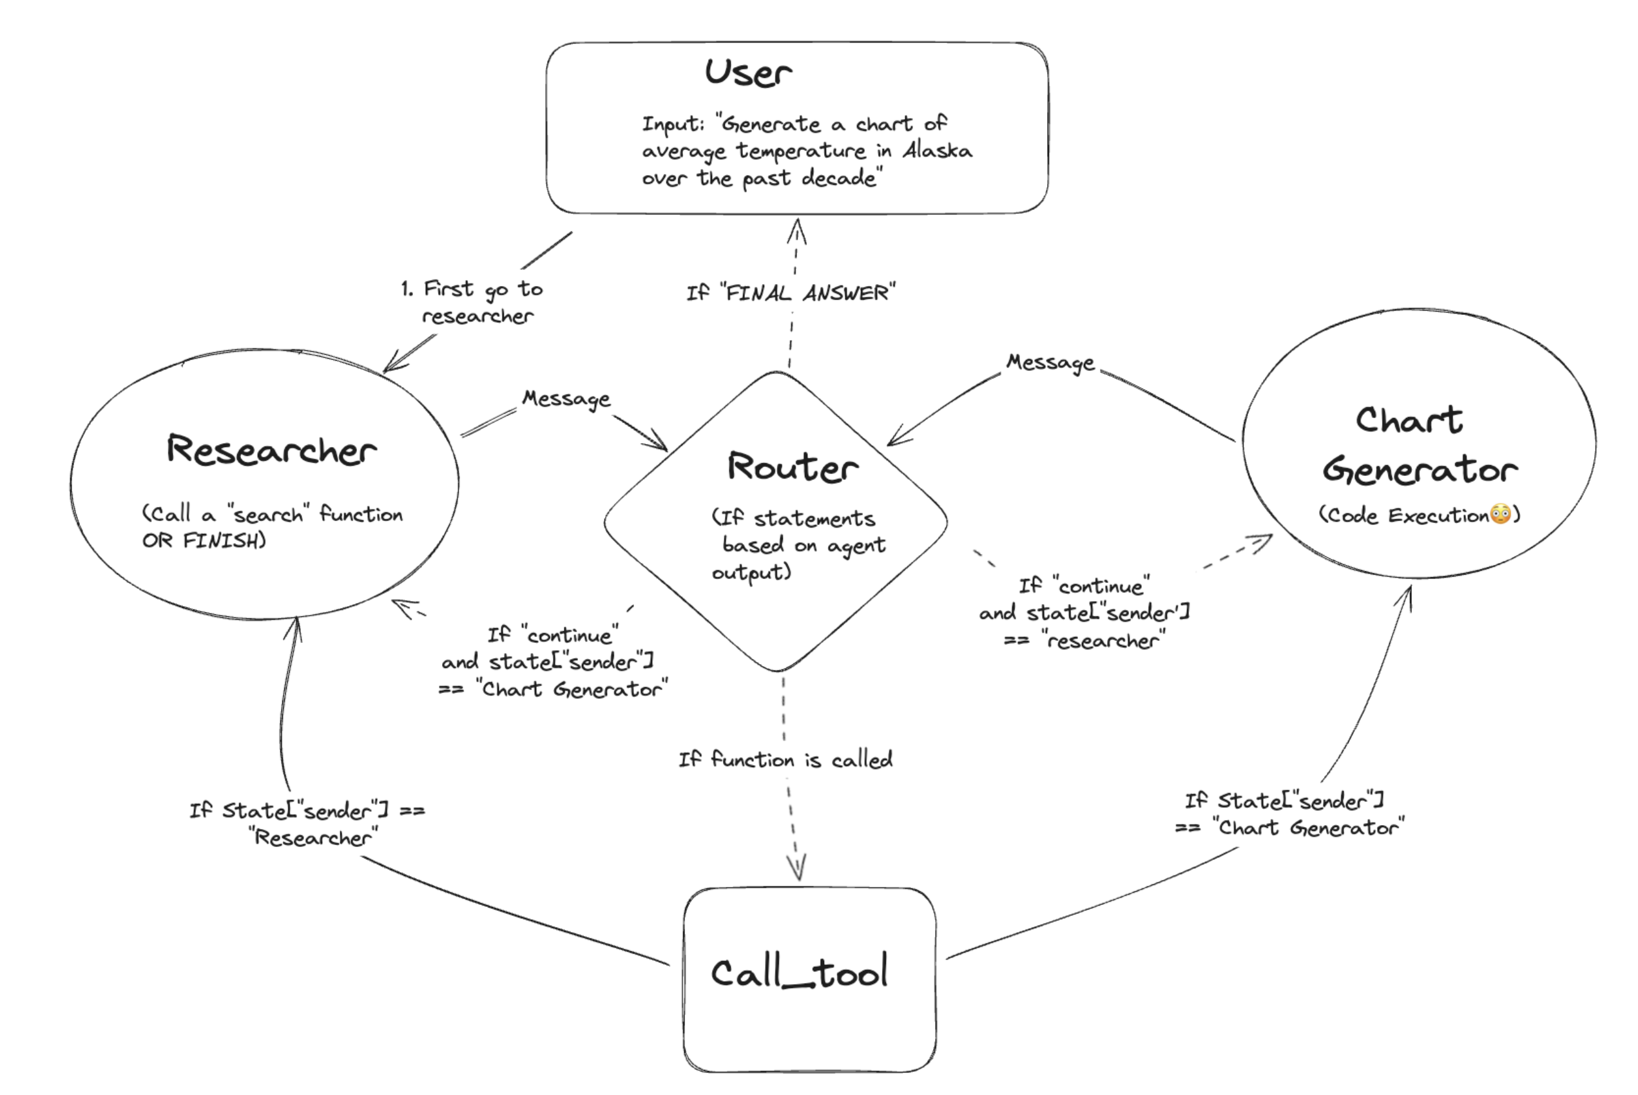
Multi-agent structures
Cooperating agents

Slide 5
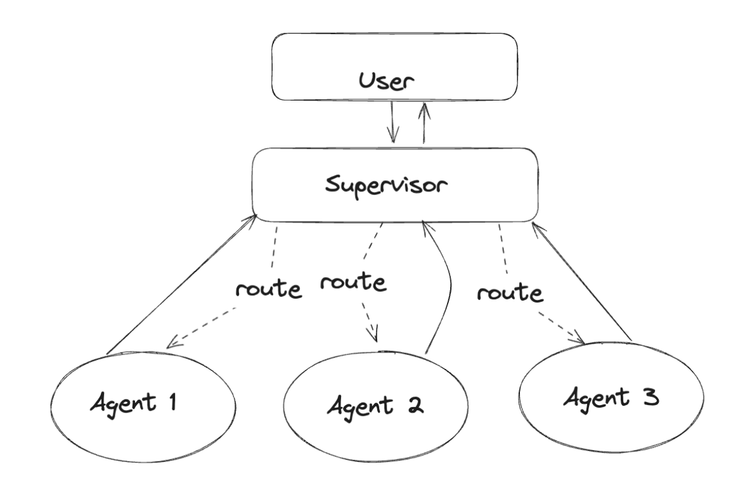
Multi-agent structures
Supervisory agent

Slide 6
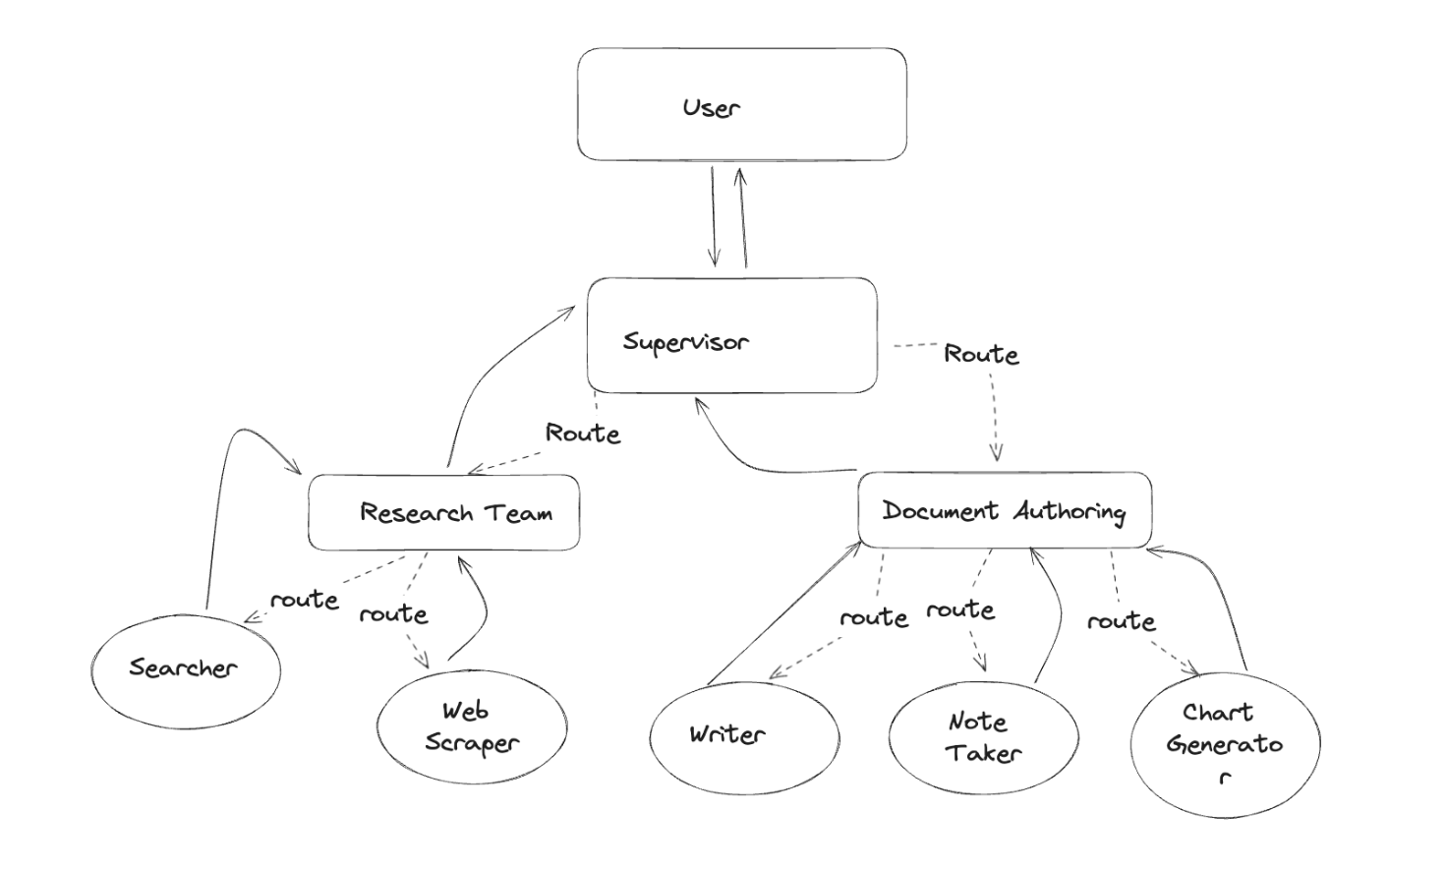
Multi-agent structures
Hierarchical teams

Slide 7
Agents may be implemented in many different ways

Slide 8




Tools
+
Language Model
Agent
Agentic AI

Slide 9
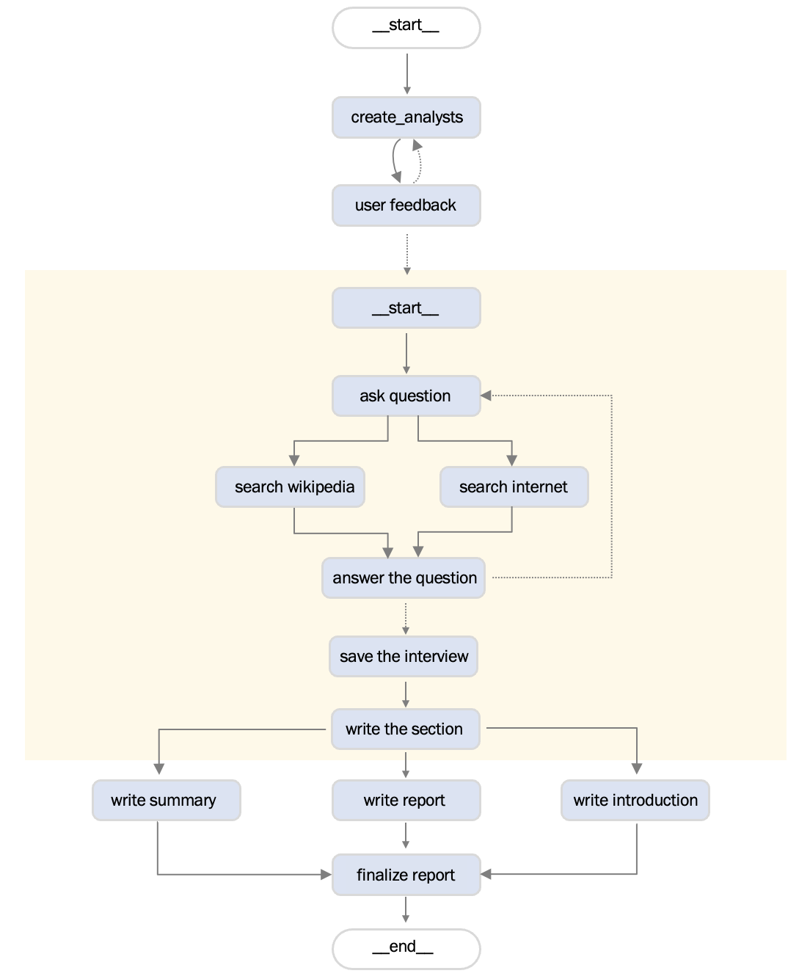

Slide 10
Agents needs to communicate

Slide 11
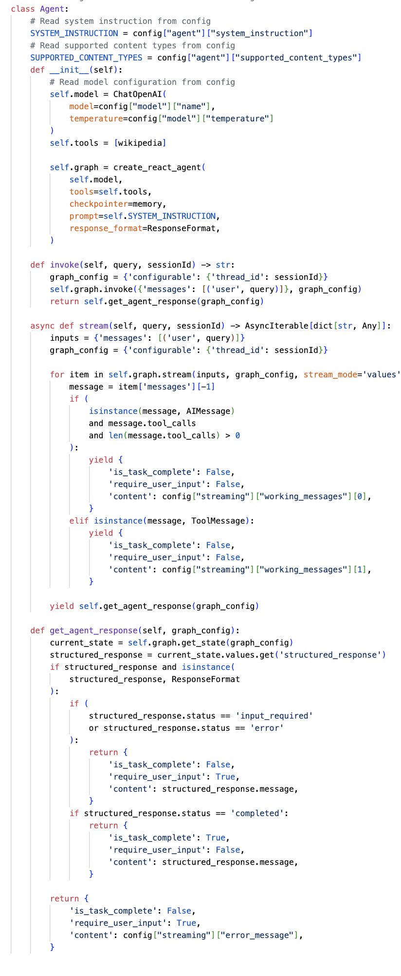


Slide 12
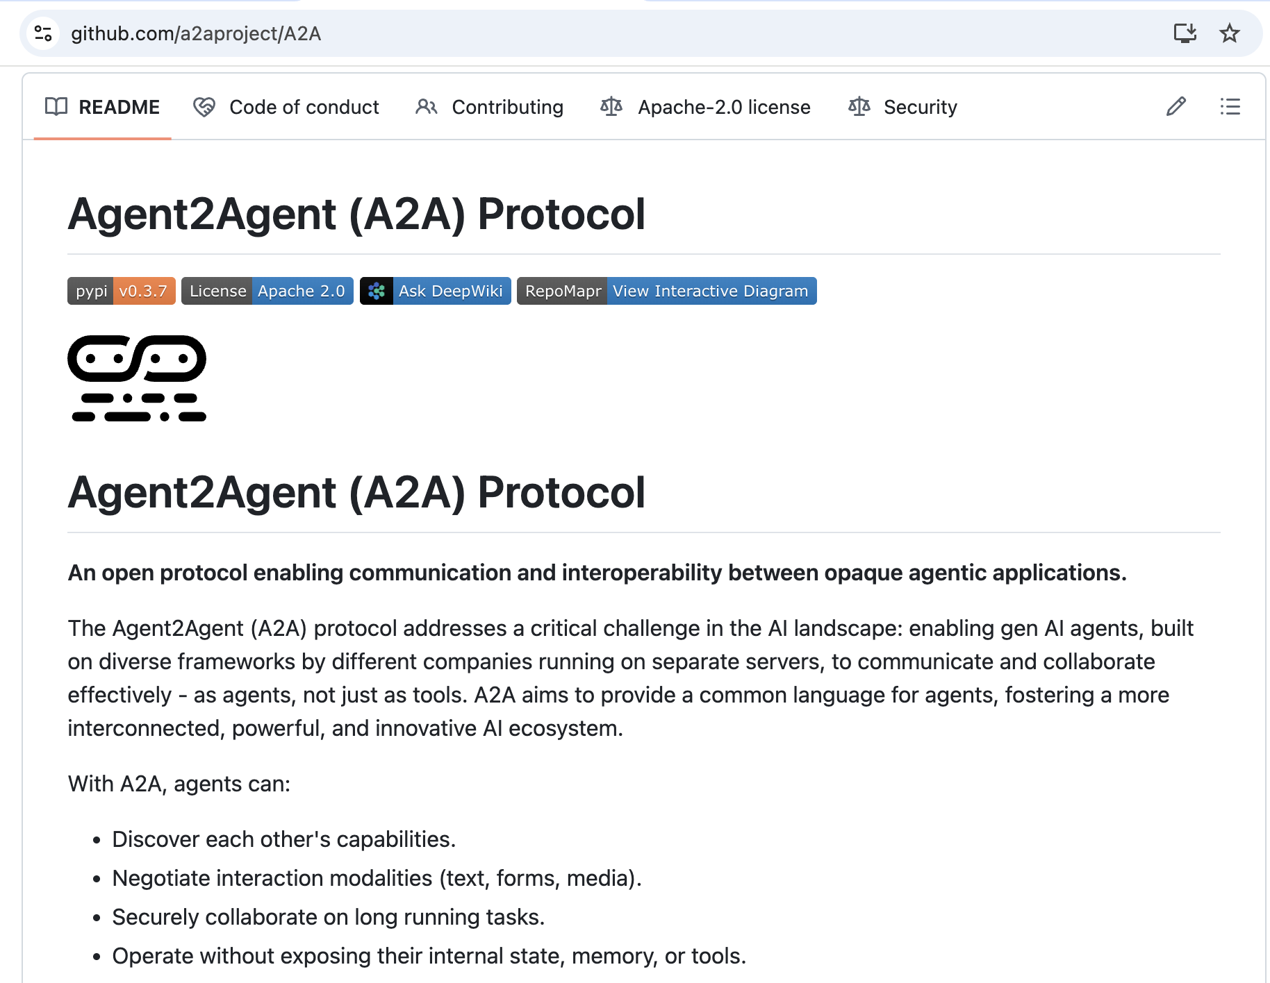

Slide 13
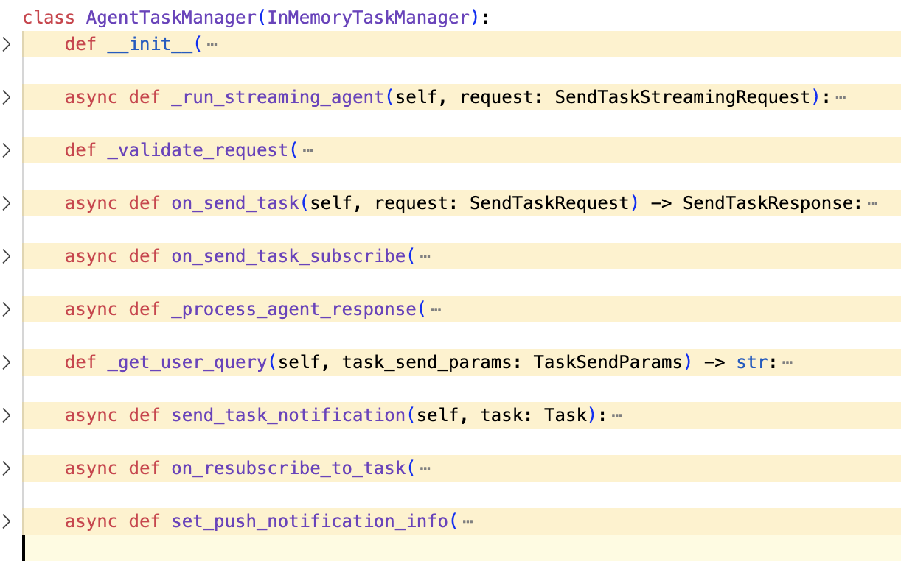
This communication needs to be managed

Slide 14
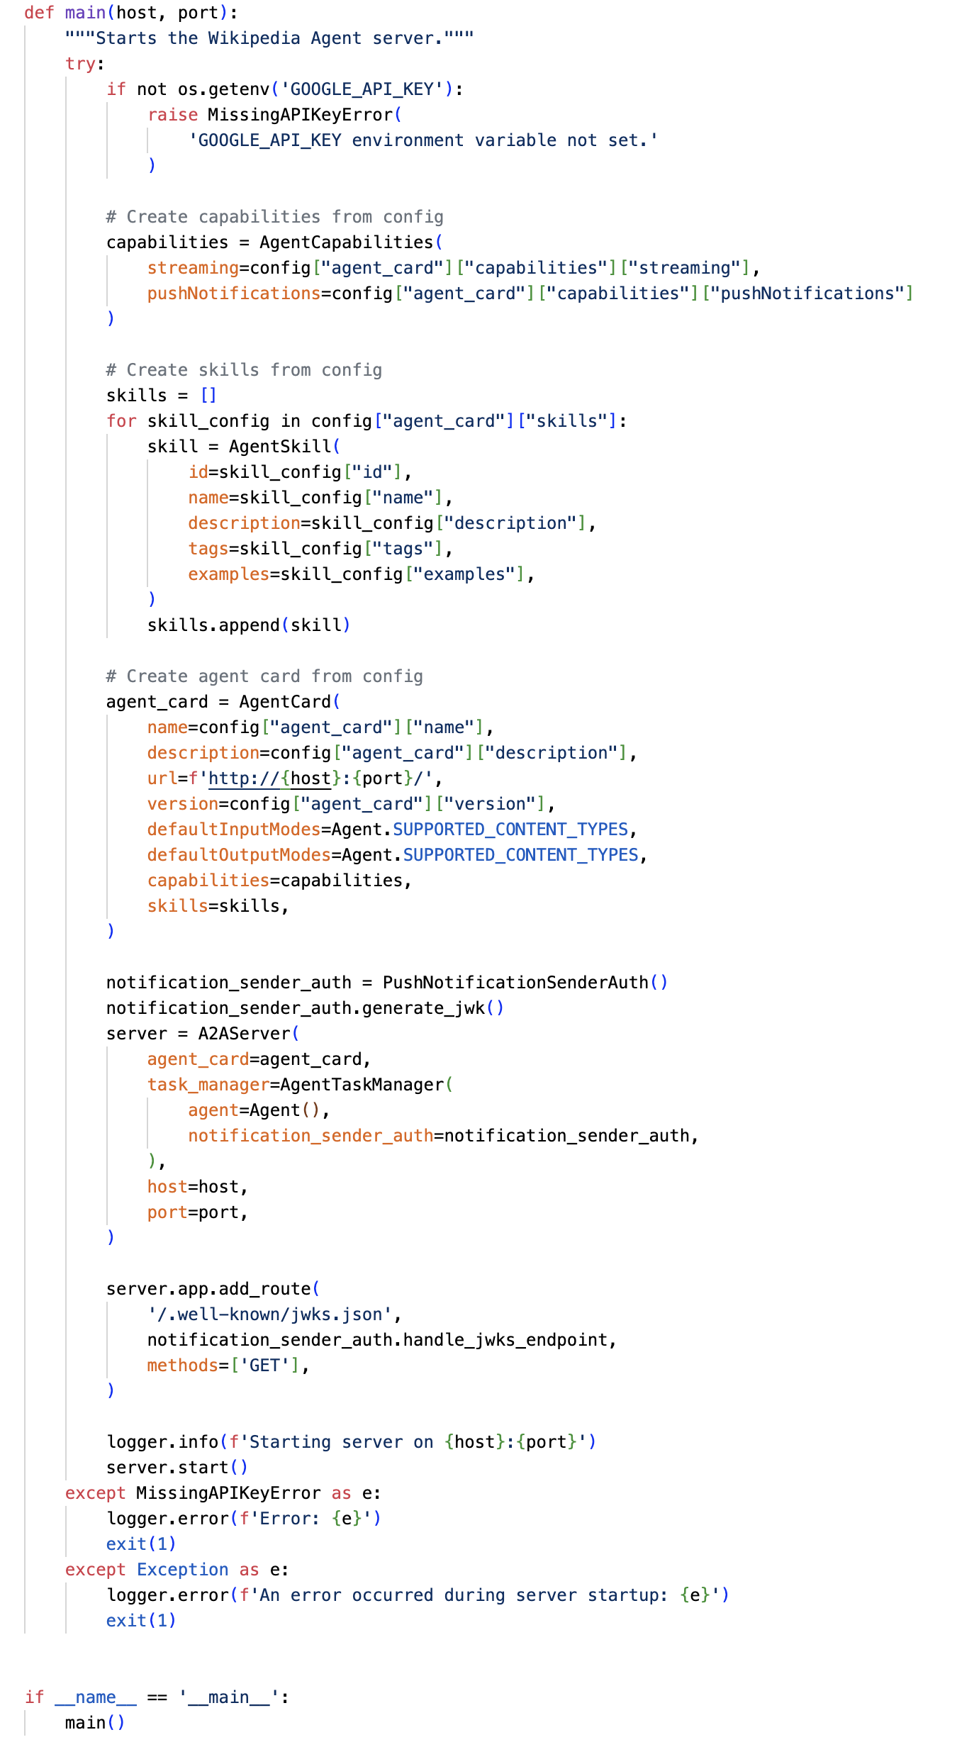
Agents needs to broadcast its skills and capabilities…

Slide 15
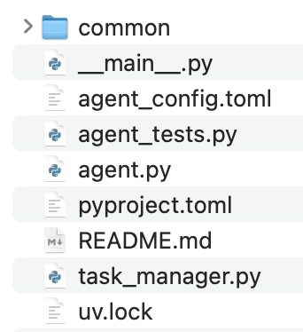
… and serve its services

Slide 16
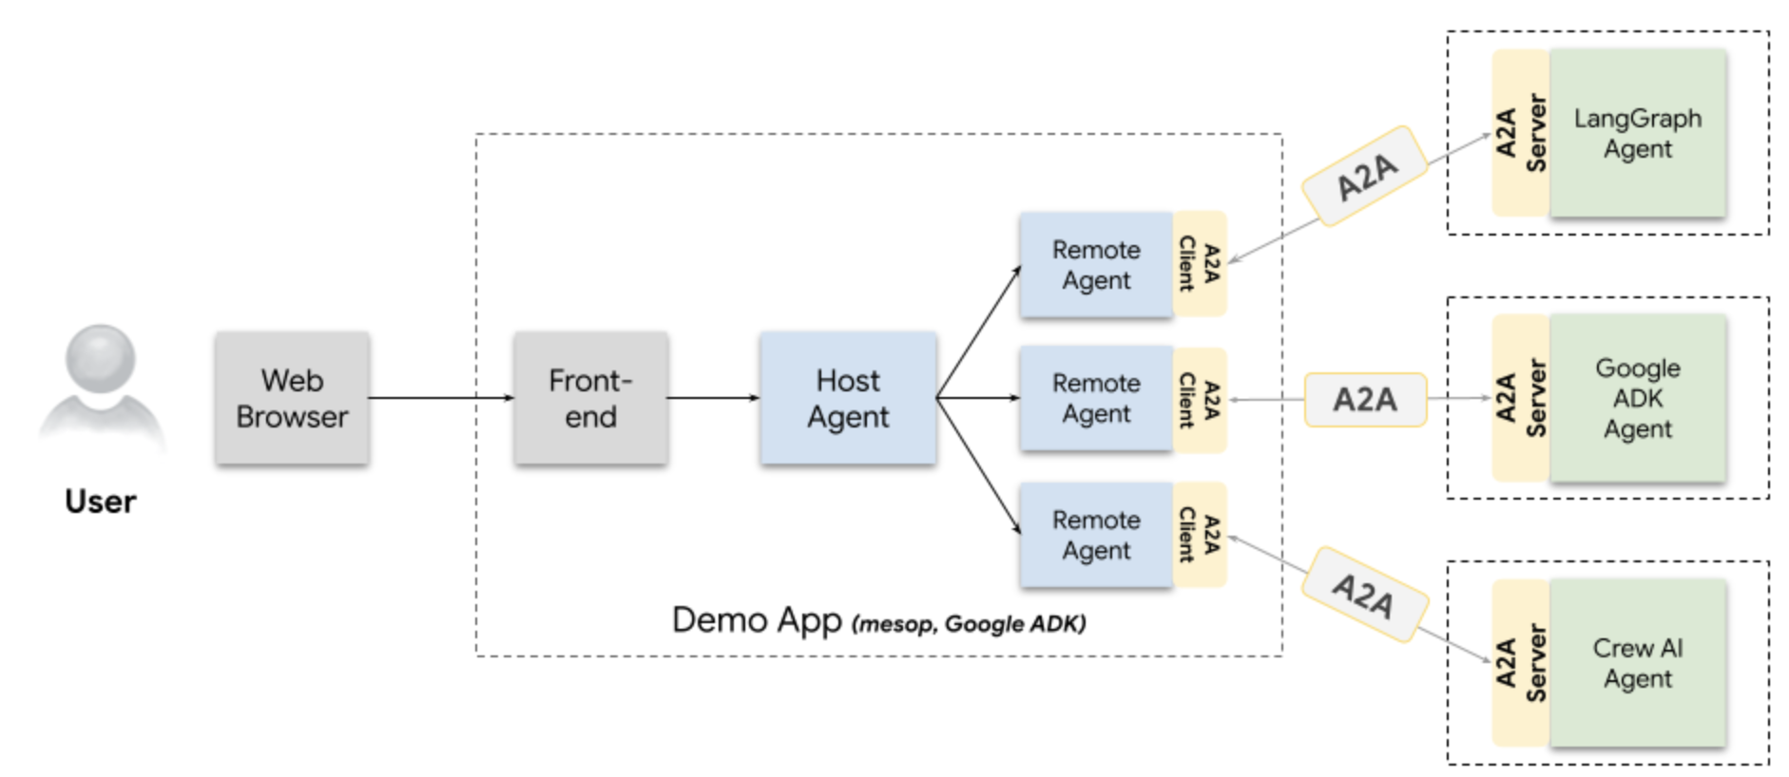

Slide 17
Control points

Slide 18
Agent
purpose
graph
LLM/SLM
deployment

Slide 19
Server
skills
deployment
capabilities
scoring
…

Slide 20
Logging
Metrics
Evaluation
Communication

Slide 21
Multi-agent logic

Slide 22
Web GUI
Frontend
Monitoring
…

